Slide 1

THE USE OF BLOCKCHAIN IN EDUCATION INDUSTRY

Slide 2

BLOCKCHAIN AND EDUCATION INDUSTRTY
The intervention of technology in every sector has given us some incredible development and paved the way for huge transformation.
Blockchain, which is the latest buzz permeating different sectors, is also disrupting the education sector positively. In this presentation, we will be exploring how Blockchain is creating a difference in the world of education and how it can benefit this sector

Slide 3

BLOCKCHAIN AND EDUCATION INDUSTRTY
Blockchain is the distributed ledger technology that provides a transparent and immutable platform for data storage. Now, this platform can be used for a multitude of purposes, from transaction records to data and other information. It is because of this versatility of Blockchain that the education sector can also reap the benefits.
The blockchain technology can store learn-ing records in a trusted, distributed manner, provide credible digital certificates, realize learning resource sharing with smart contract, and protect intellectual property through data encryption.

Slide 4
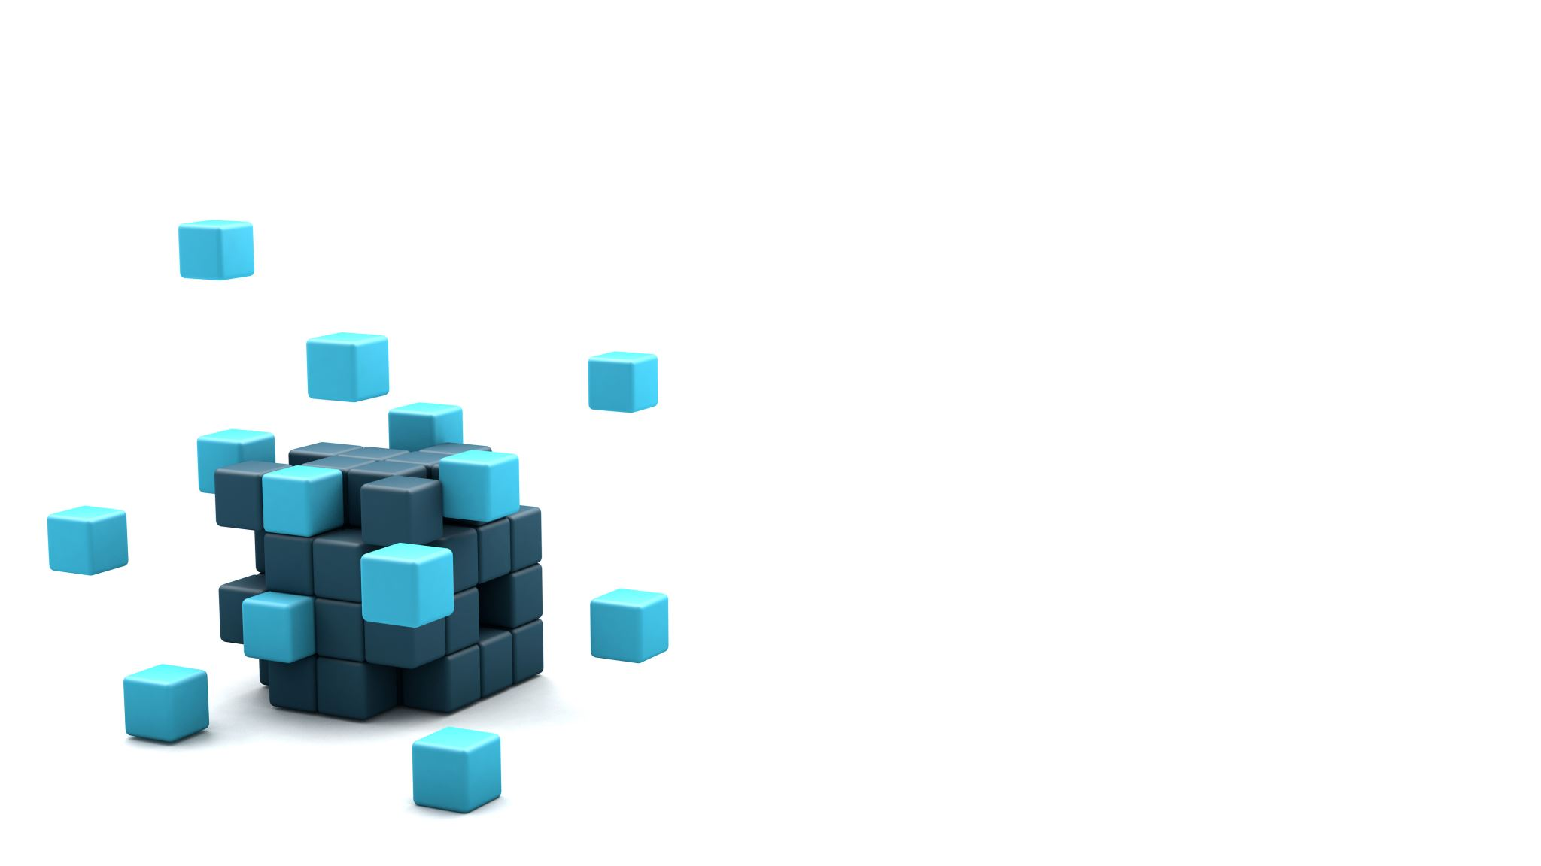
storing the academic record and certificates
It not only ensures the safety and security of data, but at the same time, it also prevents any kind of data alteration. All the information is stored in the form of blocks, and each block is associated with the other, thus even if there is an act of single block change, it will impact the other. All this makes it easy to decipher whether the data is authentic or has been altered.

Slide 5

Infrastructure security
Besides the student data, school management also shares a lot of information within the system. With Blockchain as a platform for data exchange, you can be assured of data security and makes the system free from attack.

Slide 6

Cloud storage
Students and teachers who are involved in research often need to store a lot of data and information. So, why not use DLT blockchain, which provides a safer and secured platform for data storage.
Blockchain allows personal data to stay personal to the learner. Students gain control and ownership of all their education data, including accreditation and portfolios of work, in a secure place that is accessible to anyone who needs to verify it.

Slide 7
COST EFFECTIVE EDUCATION
In a public network, blockchain allows these resources to be shared inexpensively and securely. By opening new, more affordable avenues to learning and disrupting the existing connection between schools and students, blockchain has the potential to alter the education landscape.

Slide 8
AUTHENTICITY IN RESEARCH
Majorly used for keeping authentic concepts and ideas to whom they belongs preventing the duplication and theft of data
This improves the quality of education and supports in quality research

Slide 9
Degree verification
Blockchain help in recording degree and transcripts data that are stored on decentralized applications maintaining the authenticity
Can be checked worldwide
Used to avoid tempering of records

Slide 10

Thank you

